Slide 1
19CSE303
Embedded Systems
3-0-3-4
Session 1 : Introduction
V Sem B.Tech CSE – 2021-22 Odd Sem
Department of Computer Science and Engineering
Amrita School of Engineering, Coimbatore
Amrita Vishwa Vidyapeetham

Slide 2
MOTIVATION
“The performance of future software systems will be dramatically affected ... by how well software
designers understand the basic hardware techniques at work in a system”
David A. Patterson and John L. Hennessy
“A person who is more than casually interested in
computers should be well schooled in machine
language, since it is a fundamental part of a
computer.” Donald E. Knuth

Slide 3
19CSE303 Embedded Systems 3-0-3-4
Pre-Requisite: 19CSE211 Computer Organization and Architecture
Course Objectives:
● Students will get an insight about working principles and architecture of microprocessors and microcontrollers.
Students will learn about how electronic gadgets are designed, developed and built as an embedded systems.
● This course emphasis on learn by doing and building solutions to real world problems using embedded systems

Slide 4
On successful completion of the course Embedded Systems (19CSE303) you will be able to:
describe the basic characteristics, structure and operation of a microprocessor / microcontroller system;
translate between simple high-level programming language constructs and their assembly language equivalents;
reason about the cost of executing instructions and the efficiency of simple programs;
design, construct, document and test small-scale assembly language / Embedded C programs to solve simple problems;
make use of appropriate documentation and reference material.

Slide 5
Syllabus
UNIT 1: Basics of Embedded Systems – Definition, Characteristics, Architecture of Microprocessors: General definitions of computers, micro-processors, micro controllers and digital signal processors.
ARM Architecture: RISC Machine, Architectural Inheritance, Programmers model, CPSR, ARM Organization and Implementation. 3 Stage pipeline, 5 Stage pipeline,
ARM Instruction execution, Co-processor interface, ARM Assembly language Programming, Data processing instructions, Data Transfer Instructions, Control flow instructions, Architectural support for high level programming, Thumb Instruction set.

Slide 6
Syllabus
Unit 2:
Interrupt structure - Vector interrupt table, Interrupt service routines,
Asynchronous and Synchronous data transfer schemes,
ARM memory interface, AMBA interface
Microcontroller ARM7-LPC2148 ports: GPIO, A/D Converters, PWM, timer / counter, UART and its interfacing – Embedded Programming Concepts: Role of Infinite loop, Compiler, Assembler, Interpreter, Linker, Loader, Debugger- Application development using Keil IDE.

Slide 7
Syllabus
UNIT 3:
Introduction to ARM Cortex M4 Microcontroller – GPIO and other Peripherals
System development process: Requirements, Design, Development, Testing and Deployment.
Prototyping: Analog circuit design and construction on a solderless breadboard,
Hardware and Software design, Programming simple logic and testing PLL and Systick Timers
Design strategy for building Finite State machine.

Slide 8
Text and Reference Books
Text Books:
Furber SB. ARM system-on-chip architecture. pearson Education; 2000.
Martin T. The Insider’s guide to the Philips ARM7-based microcontrollers. Coventry, Hitex, UK, Ltd. 2005.
Reference Books:
Valvano JW. Embedded Systems: Introduction to ARM Cortex-M Microcontrollers. Jonathan W. Valvano; 2016.
Valvano JW. Embedded microcomputer systems: real time interfacing. Cengage Learning; 2012.

Slide 9
Course handling Faculty members
S No | Section | Name of the Faculty Member
1 | V Sem B.Tech CSE - A | Dr S Thangavelu s_thangavel@cb.amrita.edu
2 | V Sem B.Tech CSE - B | Dr S Thangavelu s_thangavel@cb.amrita.edu
3 | V Sem B.Tech CSE - C | Dr V Anantha Narayanan v_ananthanarayanan@cb.amrita.edu
4 | V Sem B.Tech CSE - D | Dr V Anantha Narayanan v_ananthanarayanan@cb.amrita.edu
5 | V Sem B.Tech CSE – E | Mr A K Sumesh ak_sumesh@cb.amrita.edu
6 | V Sem B.Tech CSE – F | Ms Dhanya M Dhanlakshmi md_dhanya@cb.amrita.edu

Slide 10
Course Outcomes
CO | Description
CO1 | Understand the basic concepts of Embedded Systems and working of a general purpose microcontroller operations.
CO2 | Write and interpret assembly program based on the instruction set of the microcontroller
CO3 | Understand the ARM System-on-chip architecture using ARM assembly program
CO4 | Analyze how to access Microcontroller ports using Embedded C program
CO5 | Debug and verify Embedded program using a simulator and on the microcontroller.

Slide 11
Evaluation Plan – Off line
Assessment | Internal | External
Periodical 1 | 10
Periodical 2 | 10
*Continuous Assessment Theory (CAT) | 15
Continuous Assessment Lab (CAL) | 30
End Semester |  | 35
*CAT – Can be Quizzes, Assignment, Projects, and Reports

Slide 12
Evaluation Plan – On line
Components | Type | Marks | Distribution
Mid-Term ( On Line ) | Internal | 10 | On Line MCQs
Mid-Term ( Viva) | Internal | 10 | On Line Oral Viva
Continuous Assessment Theory | Internal | 15 | On Line Quizzes, Tutorials, Assignments
Continuous Assessment Lab | Internal | 30 | Minimum 5 lab Evaluations ( 5 * 6M)
End Semester Exam | External | 35 | On Line Exam (15) + Oral Viva ( 20)
*CAT – Can be Quizzes, Assignment, and Tutorials

Slide 13
On Line Tools for Lab
S No | Tools | Purpose
1 | UnoArduSim | Simulator for Embedded Control units
2 | Keil uVision 4 / 5 IDE with on line simulator | Assembler and Compiler for ARM 7 TDMI and ARM Cortex M Series MCU. Built-in On-line Simulator.

Slide 14
Lab Exercises – ARM 7 TDMI, Cortex M4
ARM Assembly Program for Arithmetic and Logical Operations.
ARM Assembly Program for Multibyte Operations
ARM Assembly Program for Control Manipulations
ARM Assembly Program for String Manipulations
ARM Assembly Program for Thumb Instructions.
Embedded C Program for ARM using Keil Simulator

Slide 15
Lab Exercises – ARM Trainer kit
1. Study of ARM Trainer Board system
2. Interfacing of Switch and LED
3. Interfacing of Keypad
4. Interfacing of DC Motor
5. Interfacing ADC and DAC.
6. Interfacing LED and PWM.

Slide 16
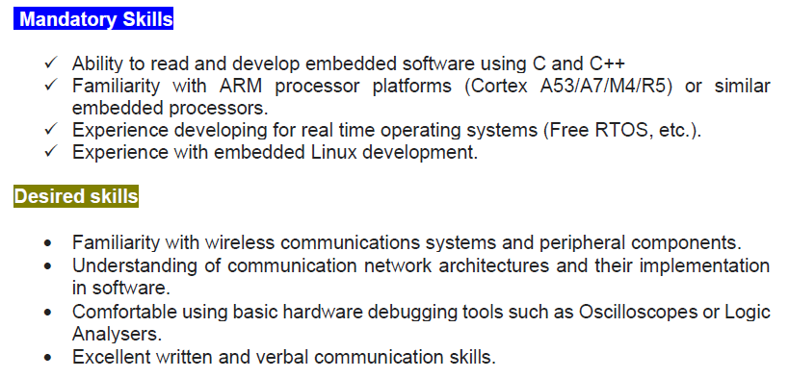
Firmware Engineer – Job Description
Master’s / Bachelor’s degree in Electronics / Electrical
Engineering, Computer Sc., Software Engineering or equivalent

Slide 17
Firmware Engineer – Job Description
Master’s / Bachelor’s degree in Electronics / Electrical
Engineering, Computer Sc., Software Engineering or equivalent
• Ability to work as a team member within an Agile/Scrum environment.
• Well versed in all monitoring and diagnostic tools necessary for software development.
• Ability to develop embedded software using C.
• Ability to create and apply methods to trap and analyze firmware and hardware defects.
• Familiarity with Coldfire processor platform or similar embedded processors.
• Understanding of communication network architectures and their implementation in software.
• Experience with real time operating systems.
• C++ hands on experience is a plus.
• Familiarity with protocol stacks (such as TCP/IP), SNMP, DHCP, UDP, TCP.
• Familiarity with developing in a Windows / Linux environment.
• Experience with development for software safety.
• Familiarity with network security practices
• Familiarity with wireless communications systems.

Slide 18
Queries ???

Slide 19
Introduction to Embedded Systems

Slide 20
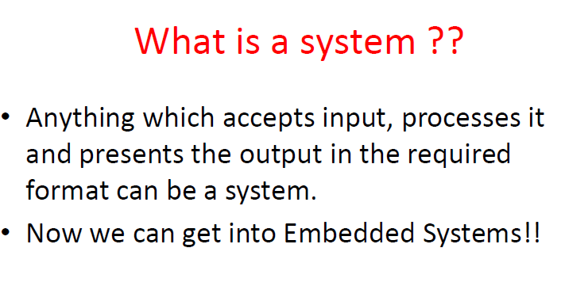

Slide 21
What is an Embedded System
Many definitions are revolving around this earth.. Let me add one more on to the count..
There are lots of definitions available for an embedded system. Out of many few are presented here:
•An Embedded system is a computing system other than desktop computers
•An embedded system is the one that has computer hardware with software embedded in it as one of its most important components
•It is any device that includes a programmable computer but is not itself intended to be a general purpose computer.
A definition that can really define embedded system is:
An electronic controller built into the application, continuously monitoring the Process Variables and ensure that the Process variables do not change; in the event of a change the controller generates a counter-acting signal and applied to the application so that the deviated Process Value is brought to its normal operating value.

Slide 22
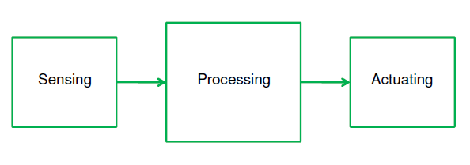
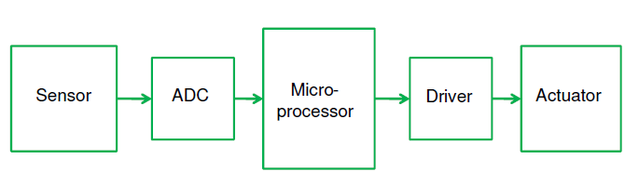
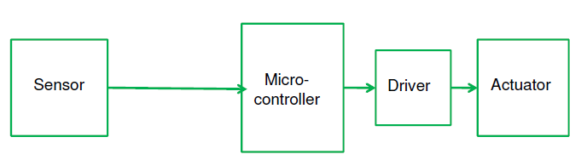

Slide 23
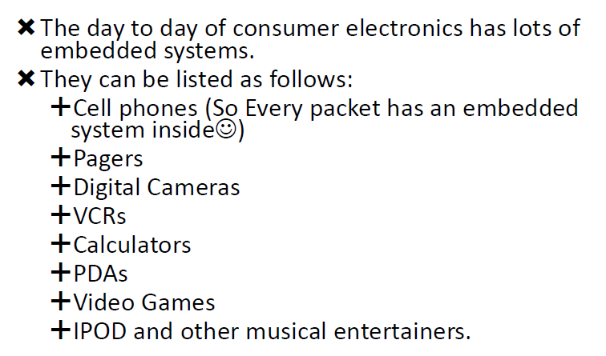

Slide 24
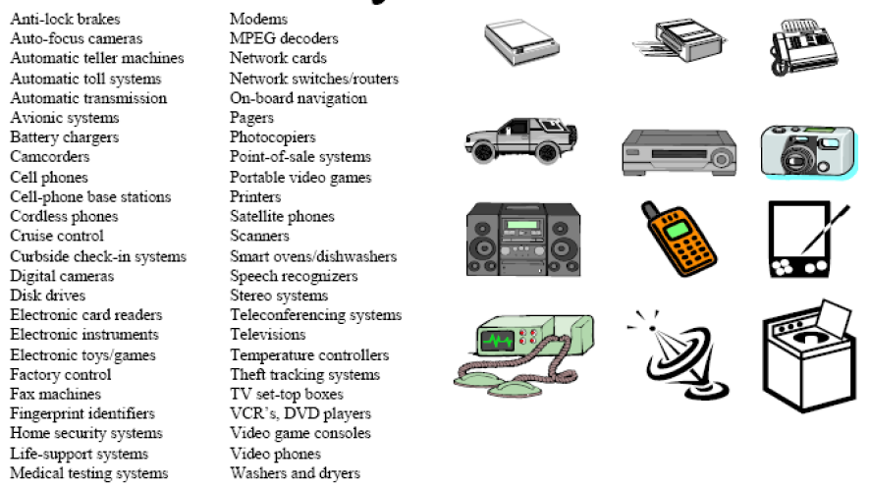
A Short List of Embedded Units

Slide 25
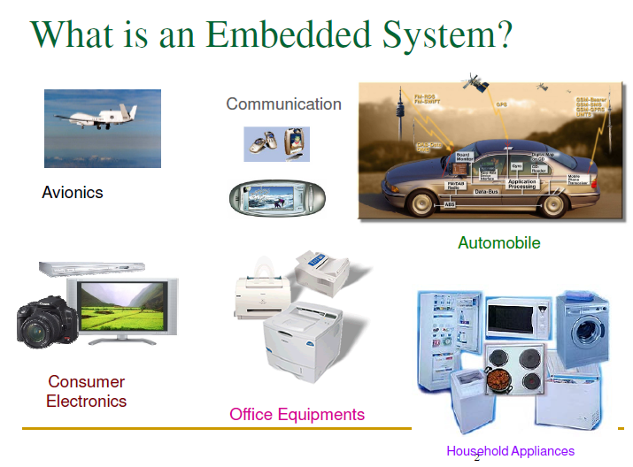

Slide 26
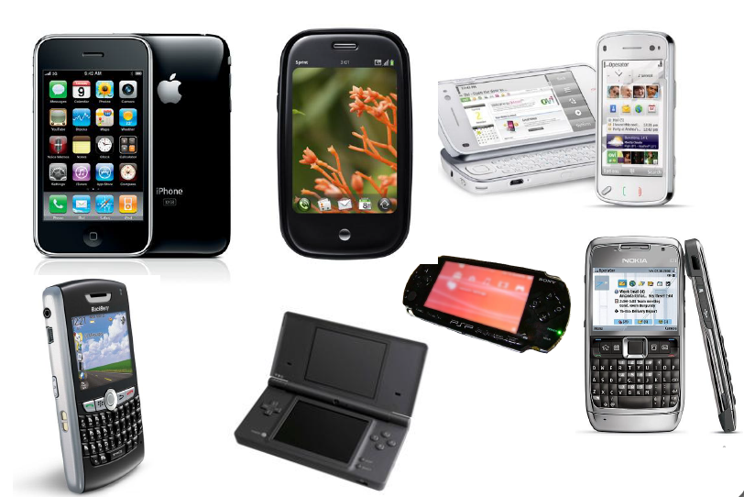

Slide 27
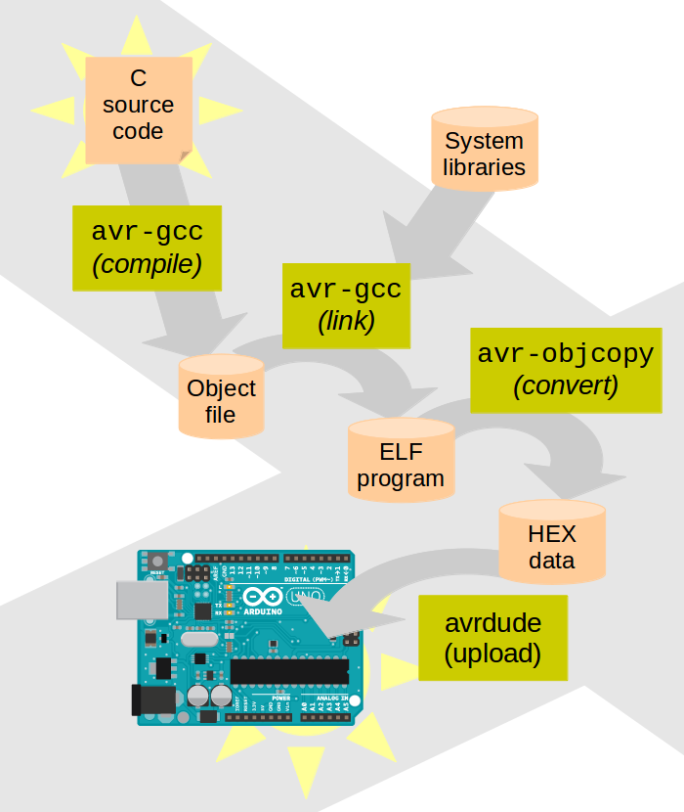
What is an Embedded System
System in which software ( firmware) is embedded into the hardware.
The core part of the system will be a programmable device.

Slide 28
Based on the application of embedded product design, it can be classified under the following categories
Automotive
Telecommunication
Healthcare
Industrial Automation
Consumer electronics
Aerospace or Aviation
Defence
Others ( including government, office automation and retail)

Slide 29
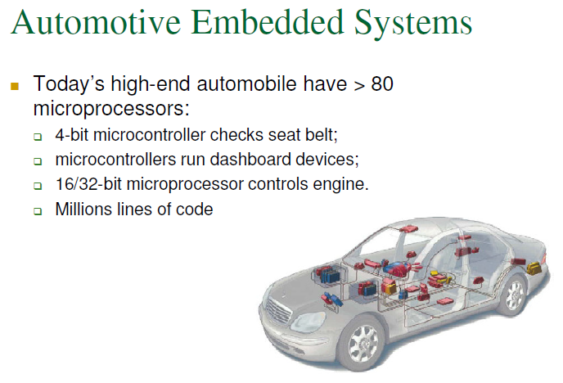

Slide 30
Why Embedded systems?
Reduced number of components.
_x0002_ Reduced size.
_x0002_ Reduced cost.
_x0002_ Reduced power consumption.
_x0002_ Easier upgradation.
_x0002_ Easier troubleshooting & maintenance.
_x0002_ Best suited for specific controlling applications.

Slide 31
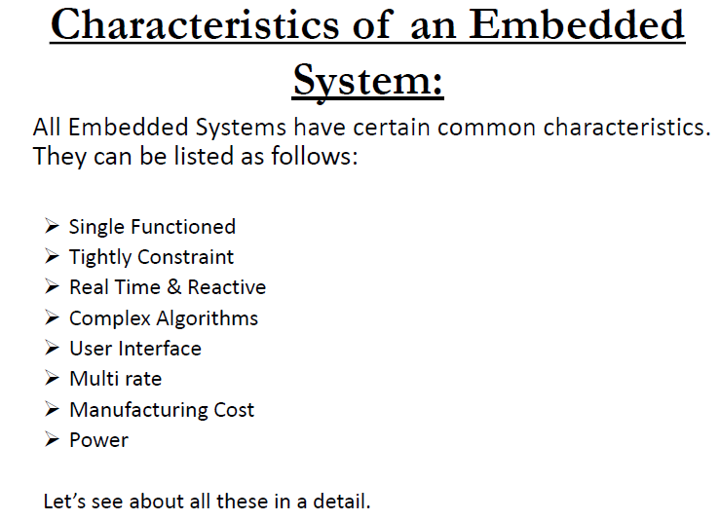

Slide 32
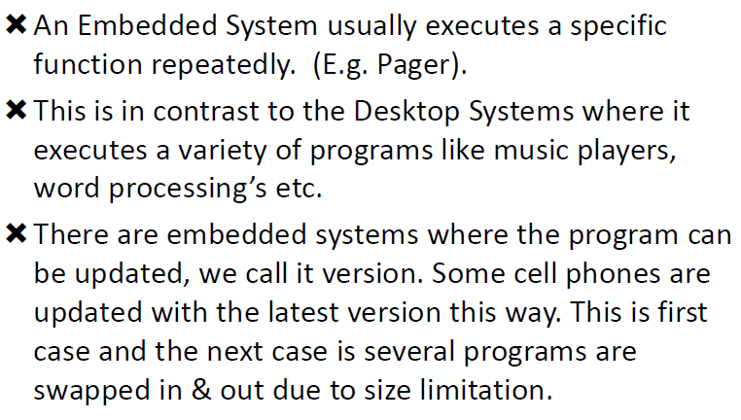
Single Function…

Slide 33
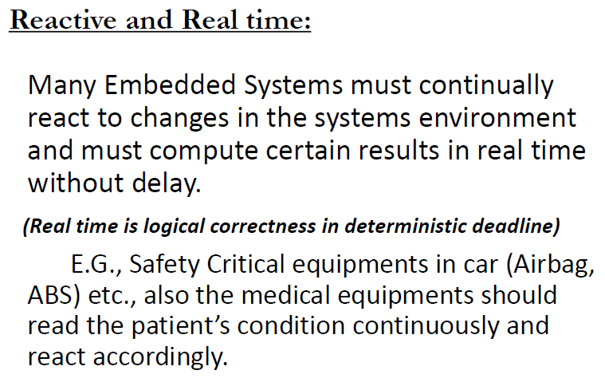

Slide 34
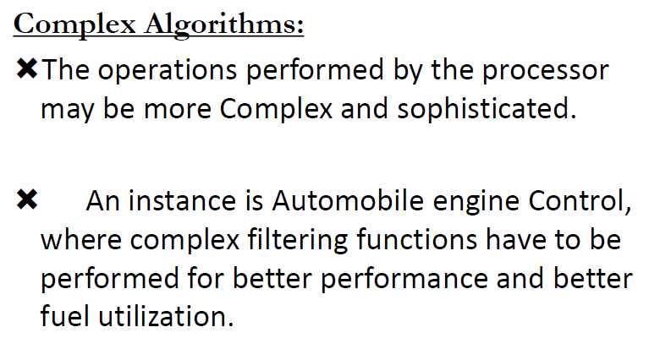

Slide 35
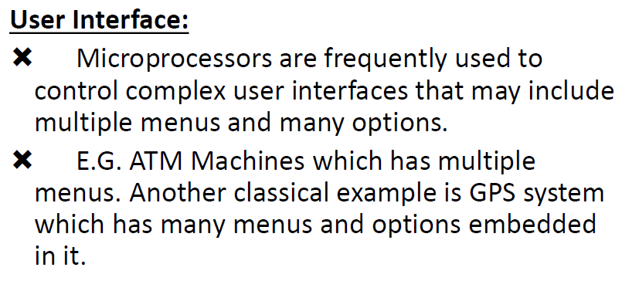

Slide 36
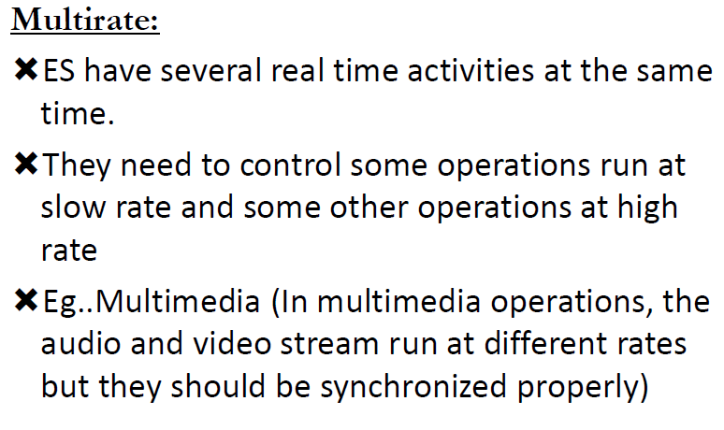

Slide 37
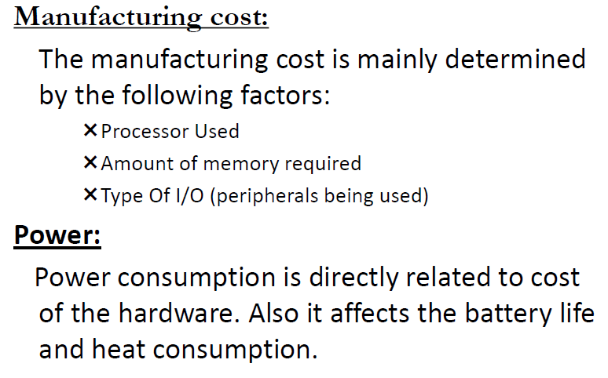

Slide 38
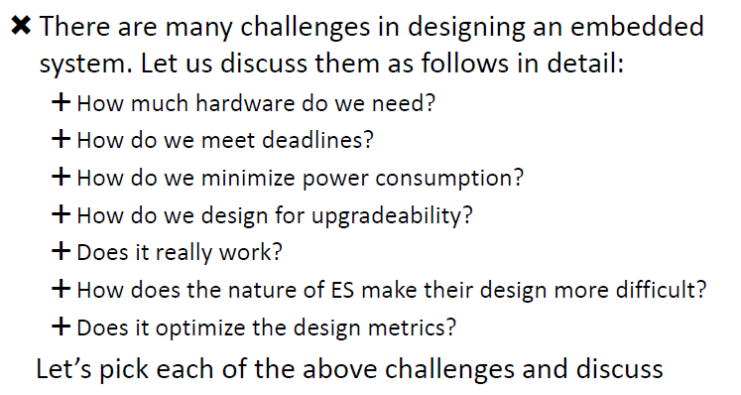
Challenges in Embedded System Design

Slide 39
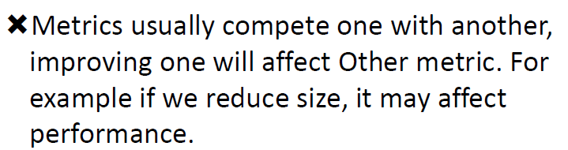
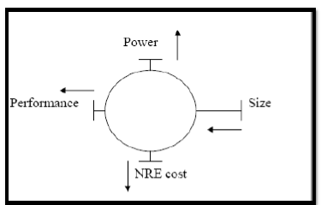
Conflicting Requirements

Slide 40
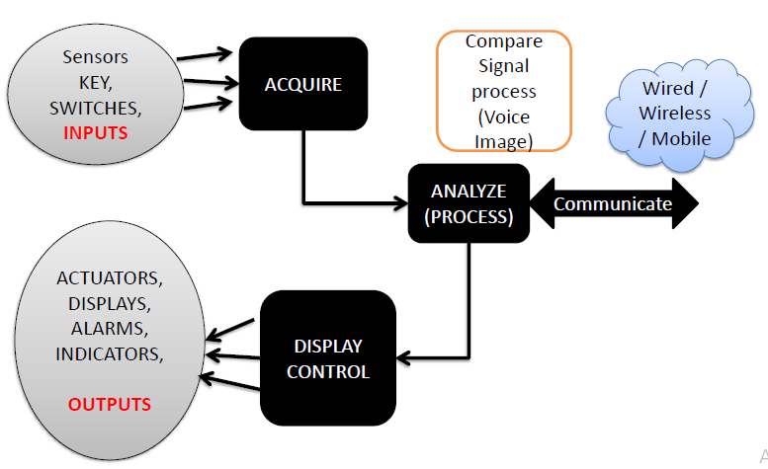
A Diagrammatic representation of Embedded System Architecture

Slide 41
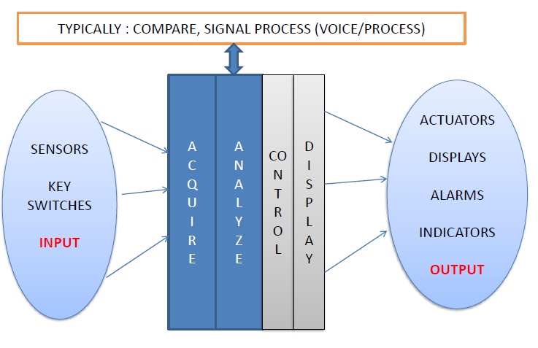
A Diagrammatic representation of Embedded System Architecture

Slide 42
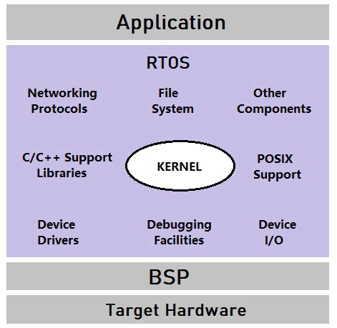
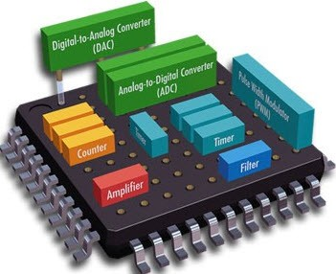
The ES has three major components and they are classified as follows:
• Hardware
• Software
• RTOS (Real Time OS)
Hardware:
The hardware can be Processor, Memory, ASIC and I/O etc including the following .
• Power supply and reset Circuits
•I/P device interfacing and driver circuits
• O/P device interfacing and driver circuits
• System application specific circuits
• Processor / controller
• Timer / Counters
• Interrupt controller
• Program and Data memory
• Parallel communication Port
• Asynchronous / Synchronous Serial Ports

Slide 43
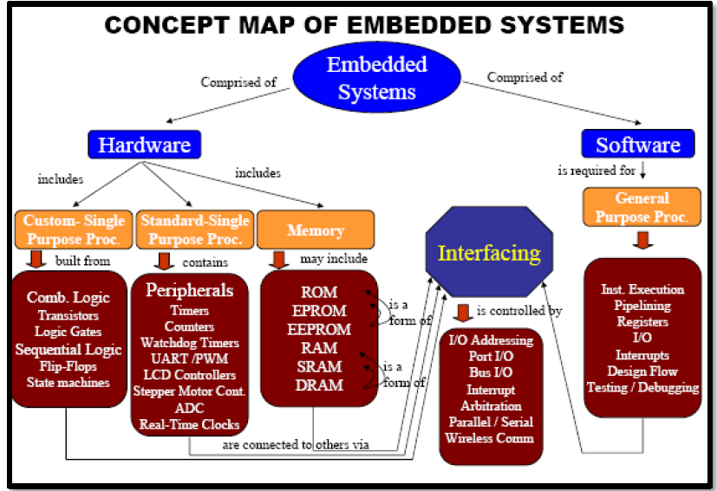

Slide 44
Simple Model of a Microprocessor based System

Slide 45
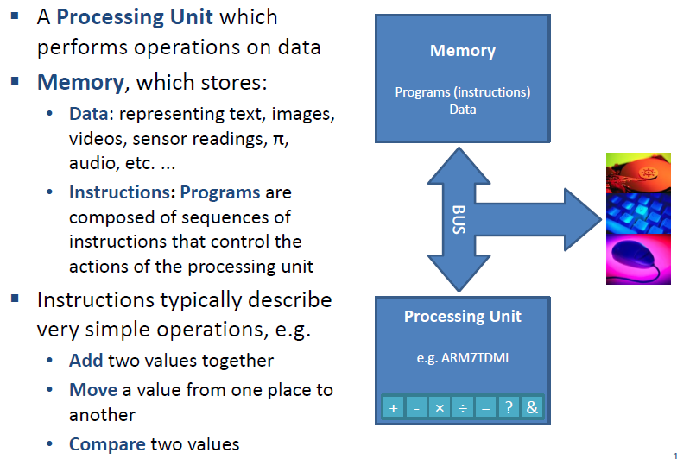
Simple Model of a Microprocessor System

Slide 46
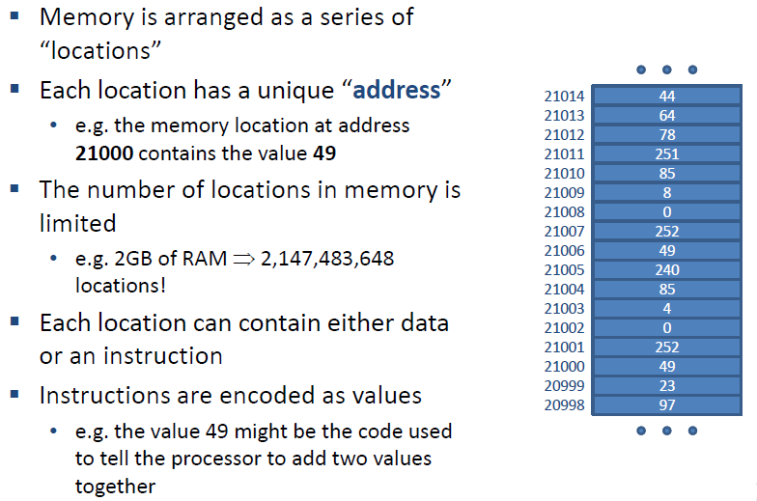
Simple Model of a Microprocessor System

Slide 47
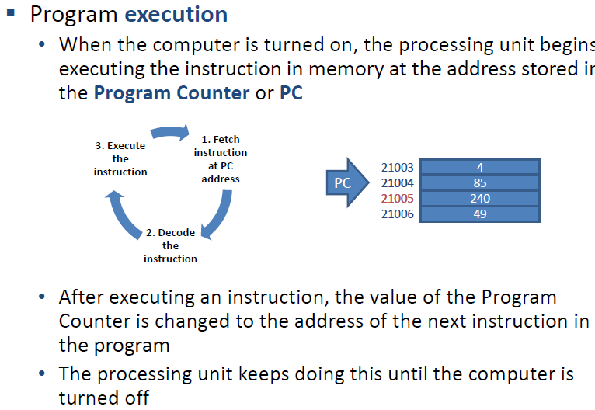
Simple Model of a Microprocessor System

Slide 48
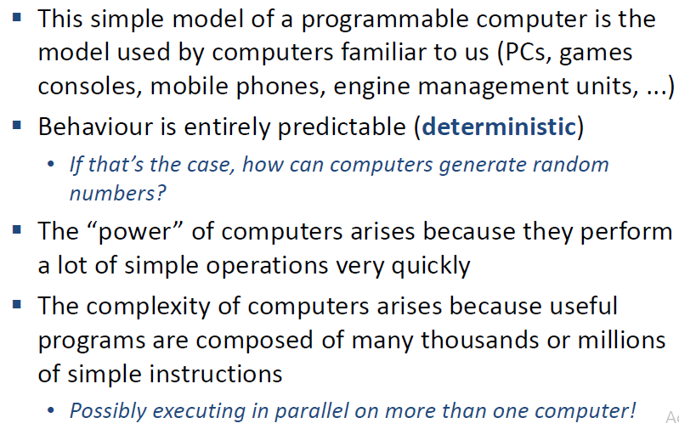
Simple Model of a Microprocessor System

Slide 49
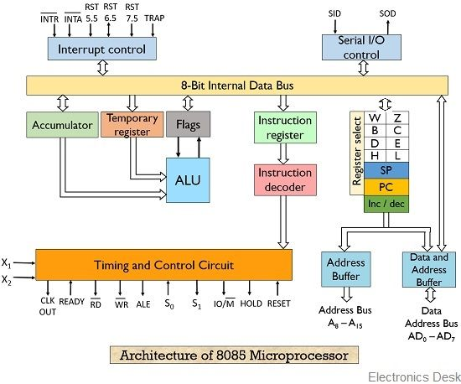

Slide 50
Peripheral Interfacing is considered to be a main part of Microprocessor, as it is the only way to interact with the external world. The interfacing happens with the ports of the Microprocessor.
The main IC's which are to be interfaced with 8085 are:
1. 8255 PPI
2. 8259 PIC
3. 8251 USART
4. 8279 Key board display controller
5. 8253 Timer/ Counter
6. A/D and D/A converter interfacing.

Slide 51
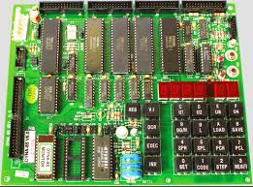
A typical 8085 (MPU) based Embedded Development board

Slide 52
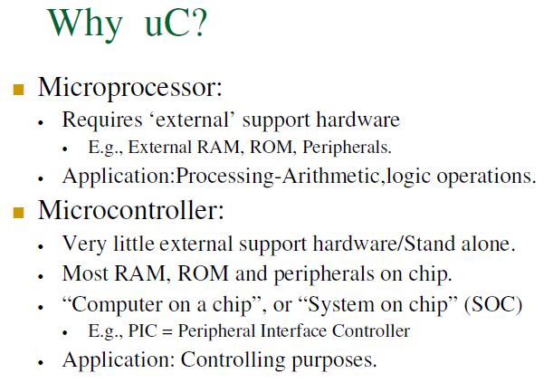

Slide 53
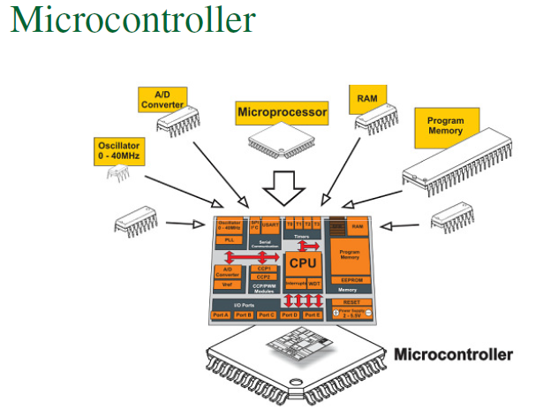

Slide 54
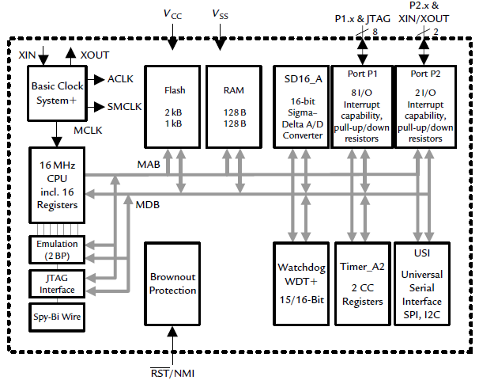
Functional Block Diagram of a MCU

Slide 55
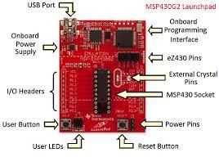
A typical MCU based Embedded Development board

Slide 56
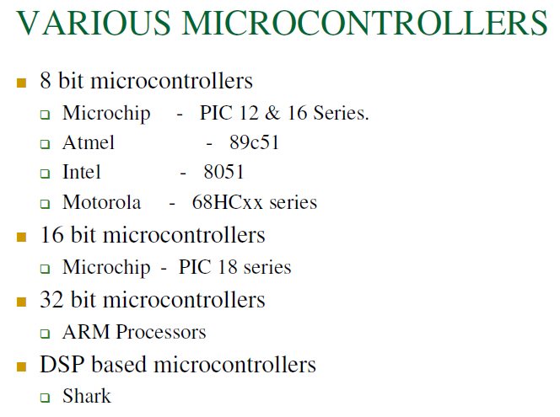

Slide 57
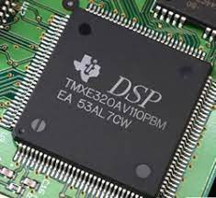
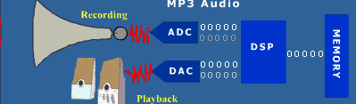
Digital Signal Processor (DSP)

Slide 58
A Digital Signal Processor (DSP) is a specialized microprocessor chip, with its architecture optimized for the operational needs of digital signal processing.
They are widely used in audio signal processing, telecommunications, digital image processing, radar, sonar and speech recognition systems, and in common consumer electronic devices such as mobile phones, disk drives and high-definition television (HDTV) products.
The goal of a DSP is usually to measure, filter or compress continuous real-world analog signals.
Most general-purpose microprocessors can also execute digital signal processing algorithms successfully, but may not be able to keep up with such processing continuously in real-time.
Also, dedicated DSPs usually have better power efficiency, thus they are more suitable in portable devices such as mobile phones because of power consumption constraints. DSPs often use special memory architectures that are able to fetch multiple data or instructions at the same time. DSPs often also implement data compression technology, with the discrete cosine transform (DCT) in particular being a widely used compression technology in DSPs.

Slide 59

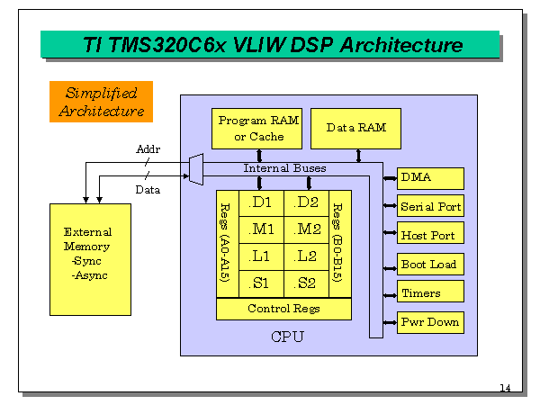

Slide 60
General application areas for DSP include
Audio signal processing
Audio data compression e.g. MP3
Video data compression
Computer graphics
Digital image processing
Photo manipulation
Speech processing
Speech recognition
Data transmission
Radar
Sonar
Financial signal processing
Economic forecasting
Seismology
Biomedicine
Weather forecasting

Slide 61
The use of Digital Signal Processors (DSP) has been immensely growing in newer applications. Digital Signal Processors (DSP), a special microprocessor chip takes its way down to, telecommunications, digital image processing, radar, sonar and speech recognition systems, and in common consumer electronic devices. Signal processing is becoming more inevitable given today’s connected and 5G drive.
Few of the Leaders: NXP Semiconductors, Texas Instruments, STMicroelectronics, Cirrus Logic, Analog Devices, Infineon, Microchip

Slide 62
Recall about RISC vs CISC, Harvard vs Von-Neumann, Little Endian vs Big Endian

Slide 63
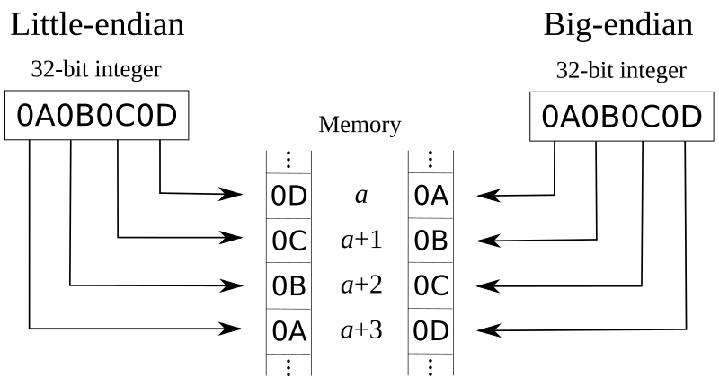

Slide 64
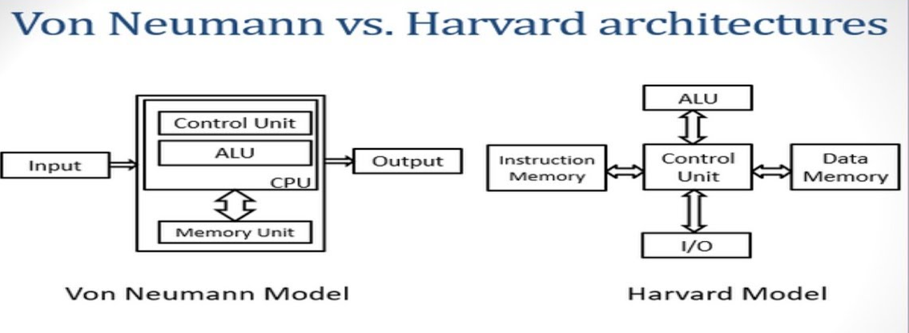

Slide 65
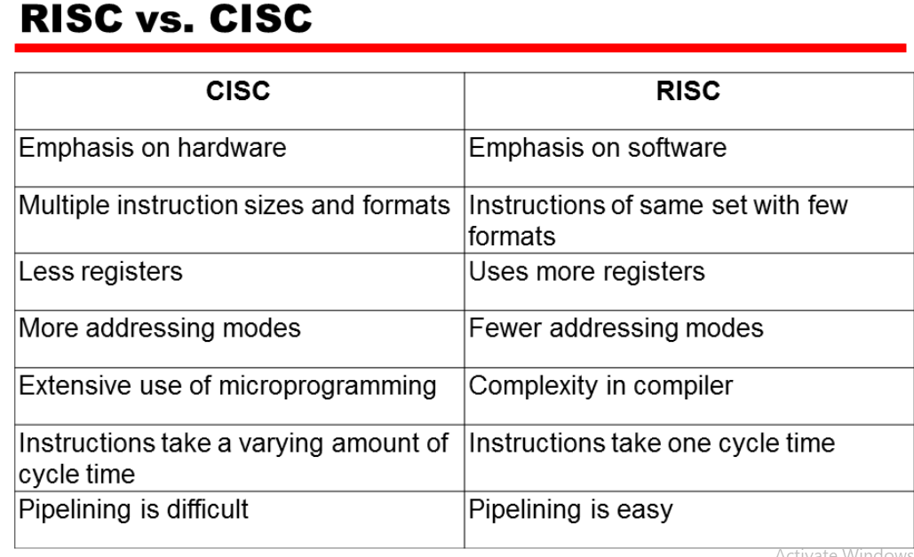

Slide 66
Queries ???

